Slide 1

Обмен одеждой… Почему это важно для Хайфы
Бэла Никитина,
эко-активист, социолог, исследователь
Хайфа - 7 марта - 2025

Slide 2
SLOW FASION, SWAP party and mending? What is it and why is it important for people and the environment
BELA NIKITINA, eco-activist, sociologist, researcher
Haifa – March 7 - 2025

Slide 3
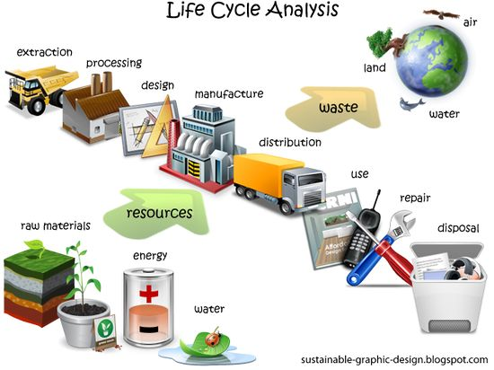
Анализ жизненного цикла продукта Life cycle analysis (LCA)
is a methodology used to assess the environmental impacts of a product or service throughout its entire life cycle, from raw material extraction to disposal.
LCA considers the environmental impacts associated with each stage of the life cycle, including energy consumption, greenhouse gas emissions, water use, and waste generation.

Slide 4
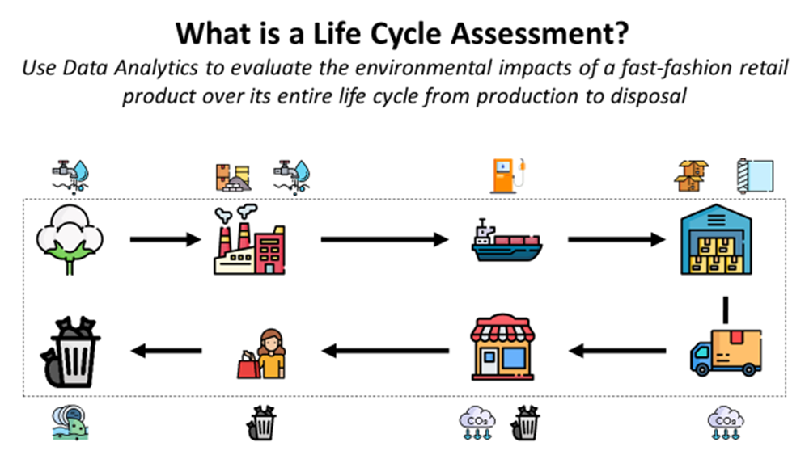

Slide 5
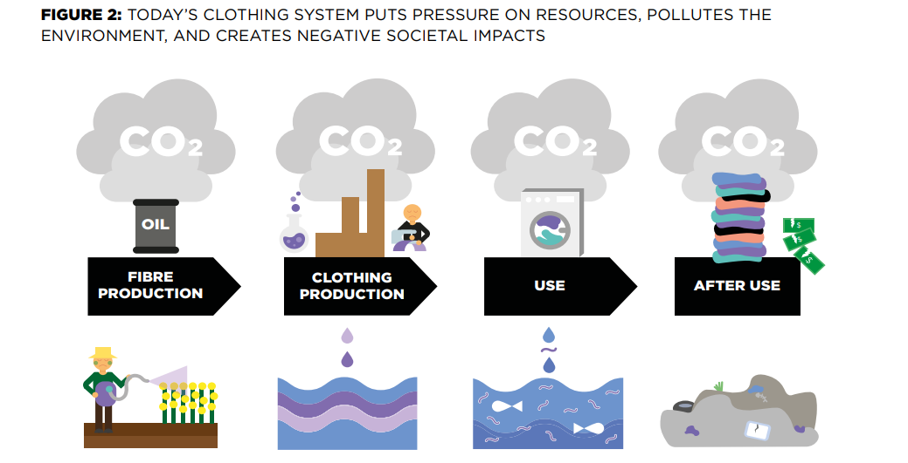
LCA in textile industry

Slide 6
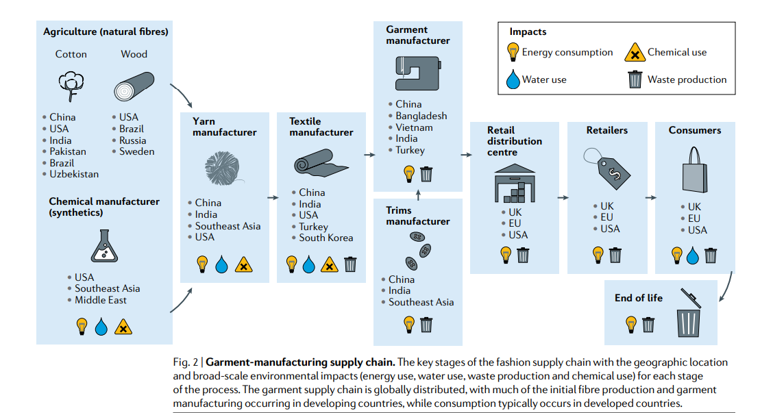
Niinimäki, K., Peters, G., Dahlbo, H., Perry, P., Rissanen, T., & Gwilt, A. (2020). The environmental price of fast fashion. Nature Reviews : Earth and Environment, 1, 189-200. https://doi.org/10.1038/s43017-020-0039-9

Slide 7
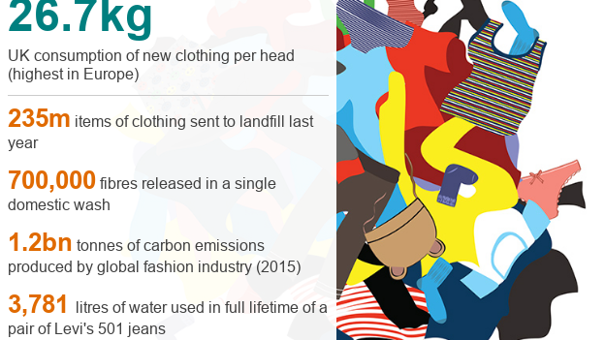

Slide 8
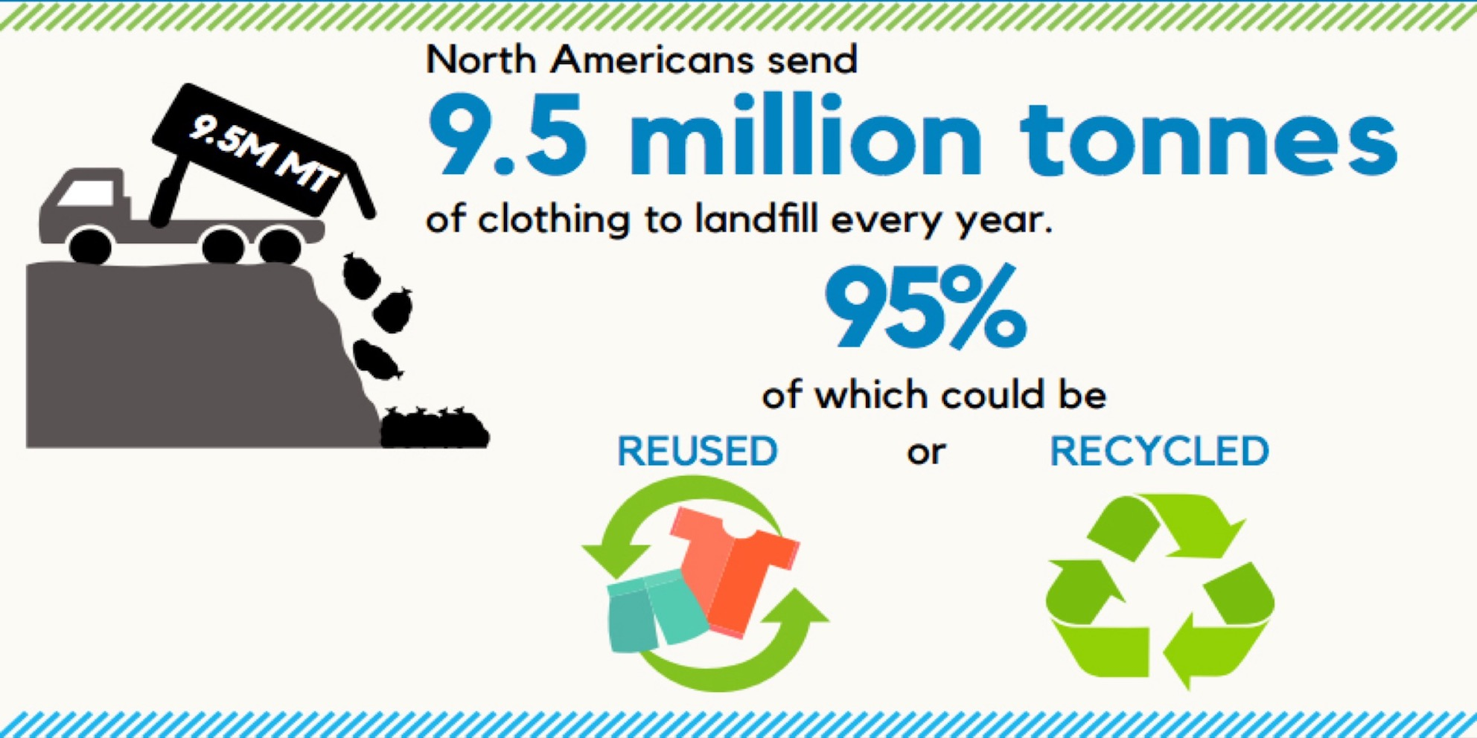

Slide 9
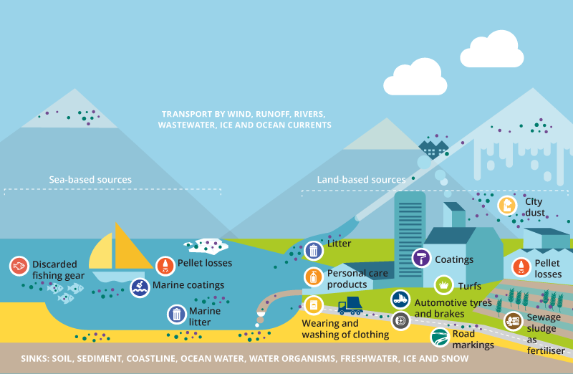

Slide 10

Sustainable development and life cycle analysis (LCA)
are closely related because they both aim to promote more sustainable practices and reduce the negative environmental impacts of economic activities. By using LCA to assess the environmental impacts of a product or service, it is possible to identify areas where improvements can be made and to promote more sustainable production and consumption practices.
Overall, sustainable development and life cycle analysis are complementary approaches that can be used together to promote more sustainable practices across a range of industries and economic activities, and to create a more equitable and sustainable future.

Slide 11
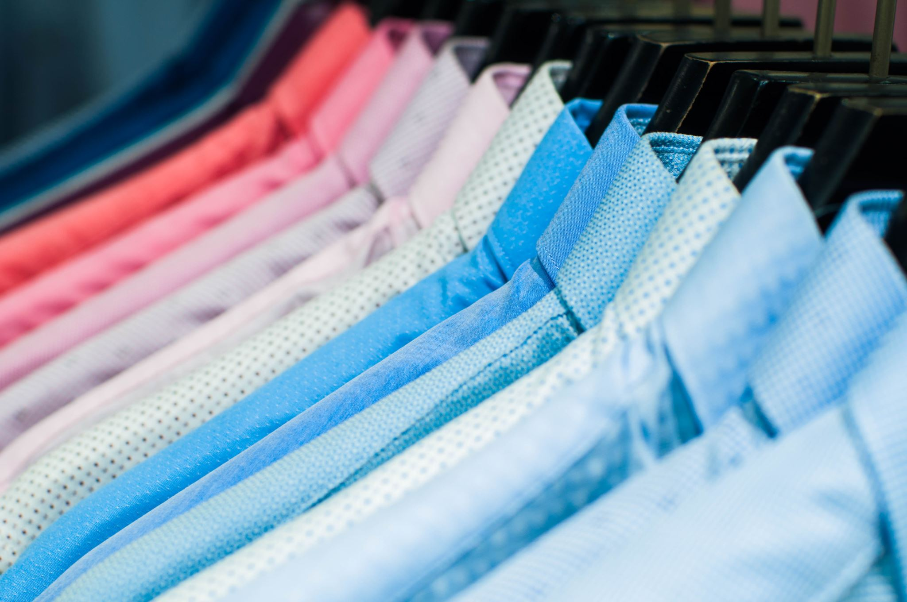
Nonprofit organizations that works to promote sustainability in the textile industry:
Fashion Revolution - https://www.fashionrevolution.org/ is a global movement that focuses on increasing transparency and accountability in the fashion supply chain, advocating for fair wages and safe working conditions for garment workers, and promoting sustainable production and consumption practices.
Textile Exchange - https://textileexchange.org/ is a global nonprofit that provide resources, tools, and standards for companies to reduce their environmental and social impact, and to increase the use of sustainable materials and production practices.
Sustainable Apparel Coalition - https://apparelcoalition.org/ is a global alliance of apparel, footwear, and textile companies that are committed to reducing the environmental and social impact of their products. They provide tools and resources for companies to measure and improve their sustainability performance, and work towards a more sustainable industry.
Redress - https://www.redress.com.hk/ is a Hong Kong-based nonprofit that works to reduce waste in the fashion industry. They run a range of initiatives, including education programs, design competitions, and clothing collection and recycling programs, to promote sustainable and circular fashion practices.
Remake - https://remake.world/ is a nonprofit that focuses on the social and environmental impact of the fashion industry. They use storytelling and advocacy to raise awareness about the issues facing garment workers and the environment, and work towards a more sustainable and ethical fashion industry.

Slide 12
Nonprofit organizations that works to promote sustainability in the textile industry (part 2)
Better Cotton Initiative - https://bettercotton.org/ - Better Cotton Initiative is a global nonprofit organization that works to make cotton production more sustainable. They work with farmers, retailers, and brands to promote sustainable farming practices, reduce water usage, and improve working conditions for farmers.
Fair Wear Foundation - https://www.fairwear.org/ - Fair Wear Foundation is an international nonprofit that works to improve labor conditions in the garment industry. They work with brands, factories, and trade unions to ensure that workers in the garment industry are treated fairly and have safe working conditions.
Greenpeace - https://www.greenpeace.org/ - Greenpeace is an international environmental organization that campaigns on a wide range of environmental issues, including the impact of the textile industry on the environment. They work to raise awareness about the environmental impact of fast fashion and promote sustainable and circular fashion practices.
The Ellen MacArthur Foundation - https://www.ellenmacarthurfoundation.org/ - The Ellen MacArthur Foundation is a nonprofit organization that promotes the transition to a circular economy. They work with businesses and policymakers to promote circular design and production practices, including in the textile industry.
Zero Waste Scotland - https://www.zerowastescotland.org.uk/ - Zero Waste Scotland is a Scottish government-funded nonprofit that works to promote sustainable and circular practices across a range of sectors, including the textile industry. They provide resources and support for businesses and individuals to reduce waste and promote circular practices.

Slide 13
Nonprofit organizations that works to promote sustainability in the textile industry (part 3)
In Israel:
Sustainable Israeli Fashion Week - https://www.sustainablefashionweek.co.il/ - Sustainable Israeli Fashion Week is an annual event that promotes sustainable fashion practices in Israel. They showcase sustainable fashion designers and provide educational resources to promote sustainable consumption practices.
The Textile Exchange Israel Hub - https://textileexchange.org/hubs/israel - The Textile Exchange Israel Hub is part of the global Textile Exchange organization (mentioned above) and provides resources and support to promote sustainable and ethical textile production and consumption practices in Israel.

Slide 14
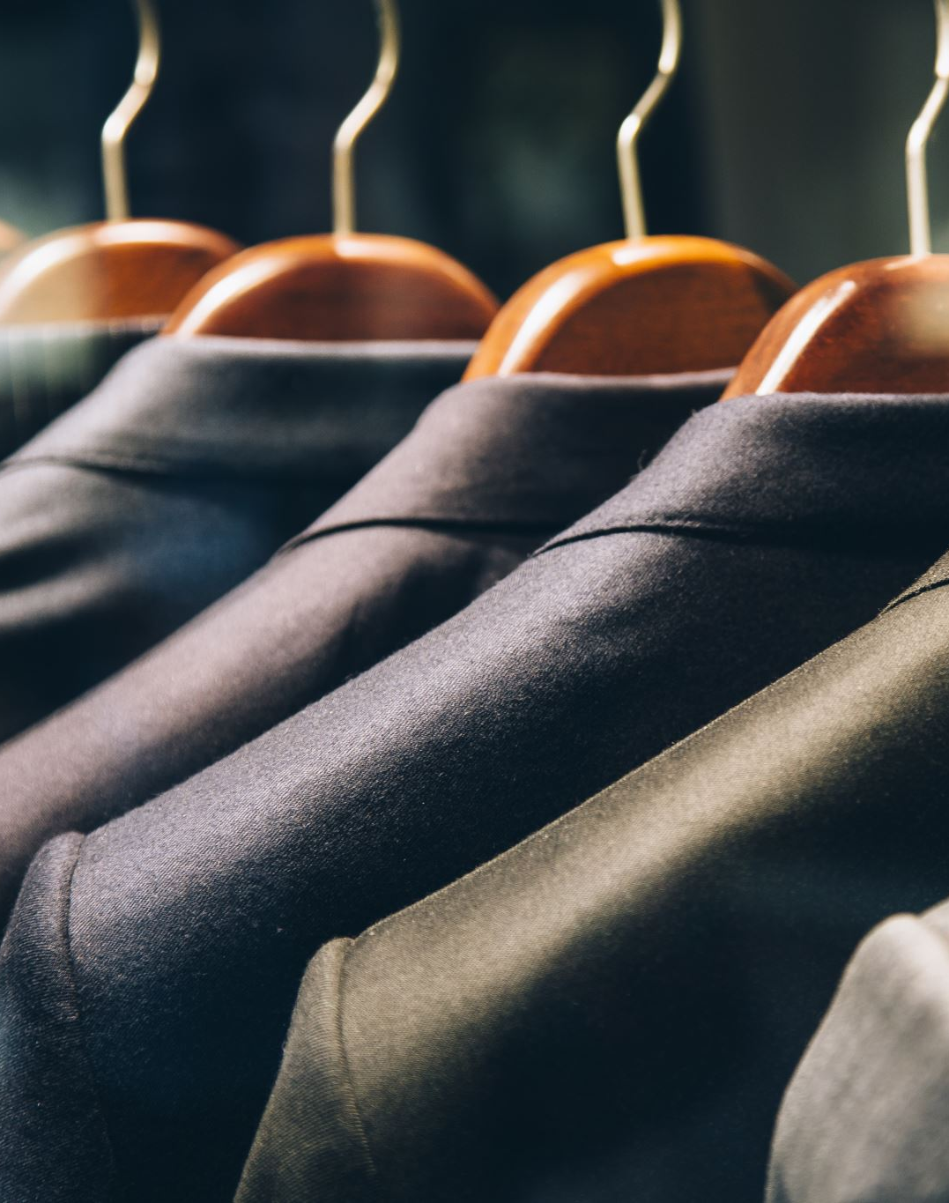
But what can be done by us as a consumers to reduce their environmental impact?
Buy secondhand or vintage clothing: One of the most effective ways to reduce the environmental impact of clothing consumption is to buy secondhand or vintage clothing. This reduces the demand for new clothing production, which in turn reduces the environmental impact of textile production and reduces textile waste.
Choose sustainable and ethical brands: Look for brands that prioritize sustainability and ethical production practices. This includes using sustainable materials, reducing water and energy consumption during production, and promoting fair labor practices.
Buy higher quality clothing: Invest in higher quality clothing that will last longer, rather than buying cheap, disposable clothing that will need to be replaced frequently. This reduces the overall environmental impact of clothing consumption and can save money in the long run.
Repair and reuse clothing: Instead of throwing away clothing that is damaged or no longer fits, try repairing or repurposing it. This reduces textile waste and extends the life of the garment.
Donate or recycle clothing: Instead of throwing away clothing that is no longer needed, consider donating it to charity or recycling it. This reduces textile waste and can benefit others in need.
Reduce overall consumption: Finally, consider reducing overall clothing consumption by buying fewer clothes and wearing them more often. This reduces the overall environmental impact of clothing production and consumption and can save money in the long run.

Slide 15
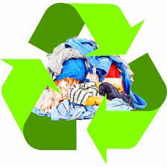
https://www.thredup.com/fashionfootprint/
WHAT’S YOUR FASHION FOOTPRINT?

Slide 16
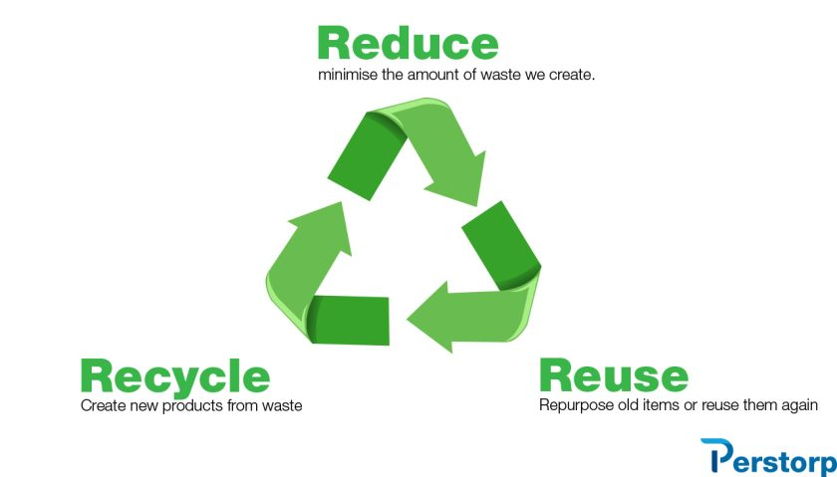
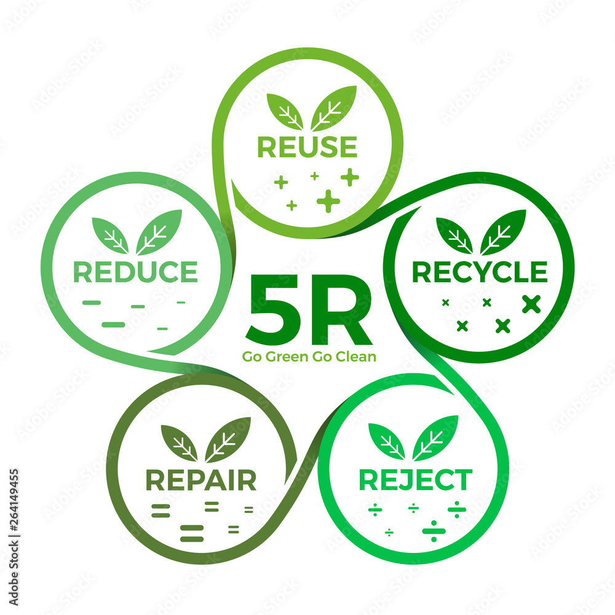

Slide 17
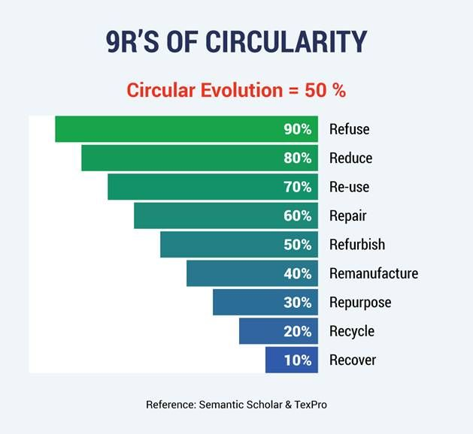
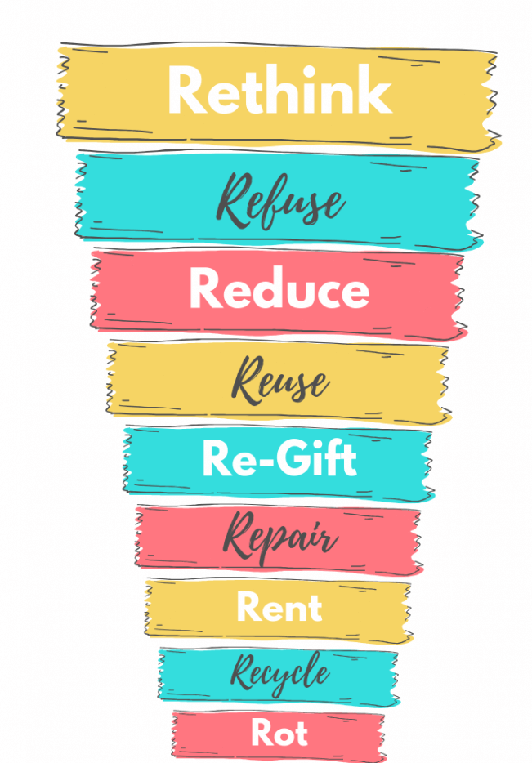

Slide 18
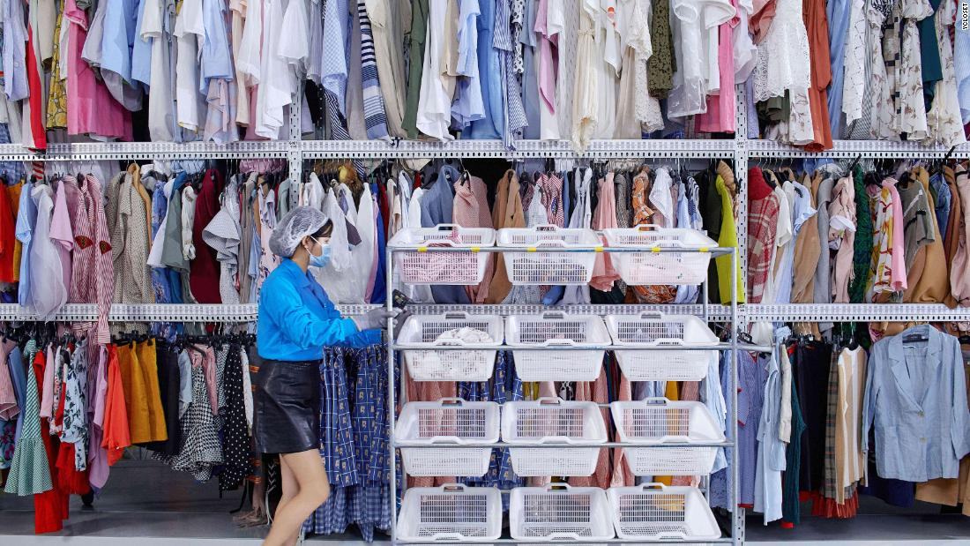
YCloset – The Chinese Renting App

Slide 19
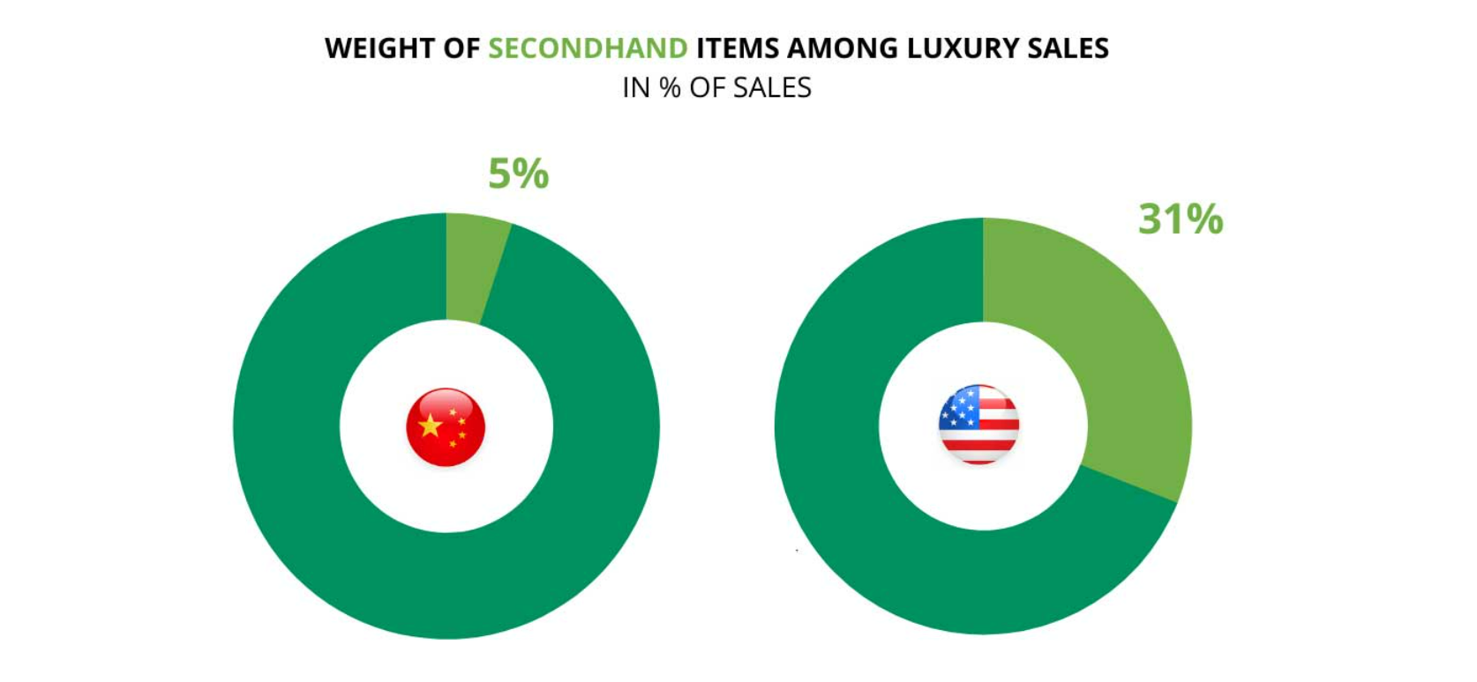
Rent your wedding or evening dress

Slide 20
Different Motivations in China vs the West
In the West 70% of people using this secondhand platform do it because they “try to shop ethically”. Even more, 57% of people mention that the environmental impact was their first concern.
In China, secondhand is not trendy because of environmental concerns.
Affordability: Chinese love to wear luxury brands. The possibility of having a rental or a secondhand service is a great opportunity for Chinese who can enjoy fulfilling a luxury lifestyle at a lower price.
Mianzi: The ability to “keep the face” is very important in China. In Chinese, mianzi literally means “the face”, and describes the tendency of local people to keep up with appearances to save their dignity and honor. Having the possibility to buy secondhand products is a new way of keeping their face in Chinese society
Waste: The tendency to have and keep numerous amounts of clothes is not seductive for the Chinese anymore. When they realized they wear some clothes only 1 or 2 times, they prefer to put them for rent or sale. It is a way to make extra money and avoid waste.

Slide 21
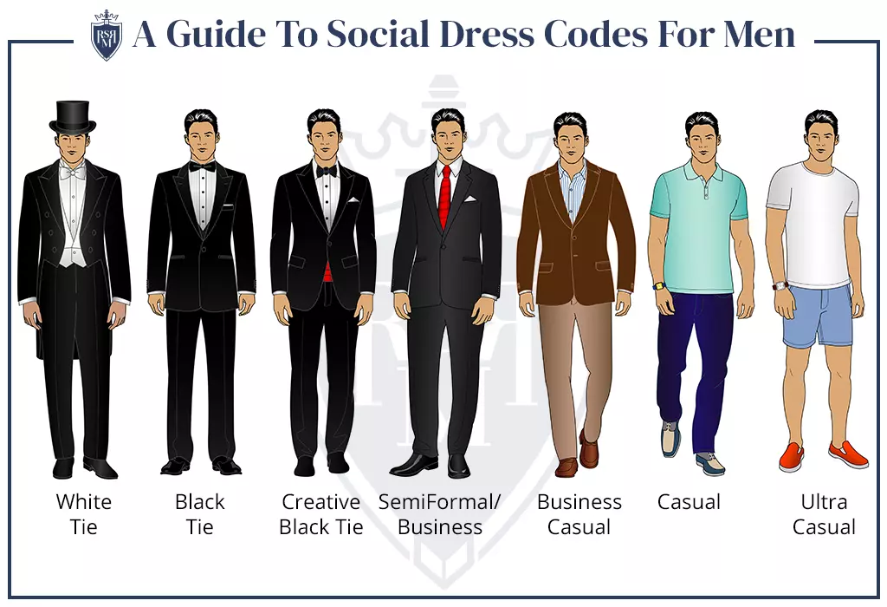
Understated luxury (slow fashion) or Fast Fashion?

Slide 22
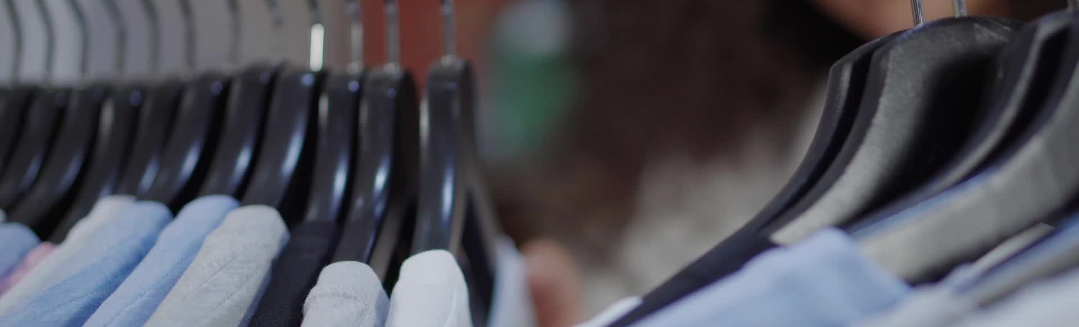
There are several types of events that could promote secondhand or vintage clothes consumption, such as:
Clothing swaps: Clothing swaps are events where people can exchange clothing items they no longer want for new-to-them items from others. These events promote sustainable fashion by reducing textile waste and providing an opportunity to acquire new clothes without buying new ones.
Vintage fashion shows: Vintage fashion shows showcase vintage clothing and demonstrate how vintage clothing can be incorporated into modern fashion trends. These events promote the use of vintage clothing as a sustainable fashion choice and can inspire attendees to consider vintage clothing as an alternative to buying new clothes.
Secondhand clothing markets: Secondhand clothing markets bring together vendors selling secondhand clothing items, providing an opportunity for people to purchase unique, vintage or pre-owned clothes. These markets can promote sustainable fashion by providing access to high-quality secondhand clothing, reducing the demand for new clothes and promoting a more circular economy.
Charity fundraisers: Charity fundraisers that focus on secondhand or vintage clothing can be a fun and sustainable way to raise funds for a good cause. These events can include clothing auctions, vintage fashion shows, or clothing swaps, with the proceeds going to a charitable cause.
Sustainable fashion workshops: Sustainable fashion workshops can be organized to teach people how to repurpose or upcycle their old clothing into something new, or to show them how to mend and repair clothing instead of throwing it away. These workshops can promote sustainable fashion practices and encourage people to take a more creative and sustainable approach to their clothing consumption.
Overall, events that promote secondhand or vintage clothing consumption can be fun and effective ways to promote sustainable fashion practices and reduce the environmental impact of the textile industry.

Slide 23
Educational or public events
Workshops: Hosting workshops that provide hands-on experience in creating sustainable and ethical clothing can help people understand the effort and resources required to create sustainable clothing. These workshops can cover topics such as sourcing sustainable fabrics, natural dyeing, ethical production, and upcycling.
Fashion Shows: Fashion shows featuring sustainable and ethical clothing brands can showcase the style and creativity of these brands while highlighting their values and mission. These shows can be an opportunity for people to see how sustainable and ethical clothing can be stylish and trendy.
Expert Panels: Hosting expert panels featuring professionals in the sustainable and ethical clothing industry can provide a platform for people to ask questions and learn more about sustainable and ethical practices. These panels can cover topics such as sustainable fabrics, ethical production, and fair trade.
Clothing Swaps:
Hosting clothing swaps can be a fun and interactive way for people to exchange their clothing and learn about sustainable fashion. These events can promote recycling, upcycling, and reducing waste while educating people about the impact of fast fashion.
Pop-up Shops: Pop-up shops featuring sustainable and ethical clothing brands can give people a chance to touch and feel the clothing while learning about the brands and their practices. These shops can also offer educational resources and information about sustainable fashion.

Slide 24

Sustainable and ethical fashion events in USA
The Green Festival
- This annual event takes place in multiple cities across the US and features a sustainable fashion marketplace, where people can learn about and purchase sustainable and ethical clothing.
Ethical Fashion Show
- This event takes place in New York City and features designers who prioritize ethical production and sustainability in their clothing lines.
Eco Fashion Week –
This event takes place in multiple cities across the US and Canada and features sustainable and ethical fashion designers who use eco-friendly materials and production methods.
Fashion Revolution Week - This international event takes place in multiple countries, including the US, and aims to raise awareness about the true cost of fashion and promote sustainable and ethical practices in the fashion industry.

Slide 25
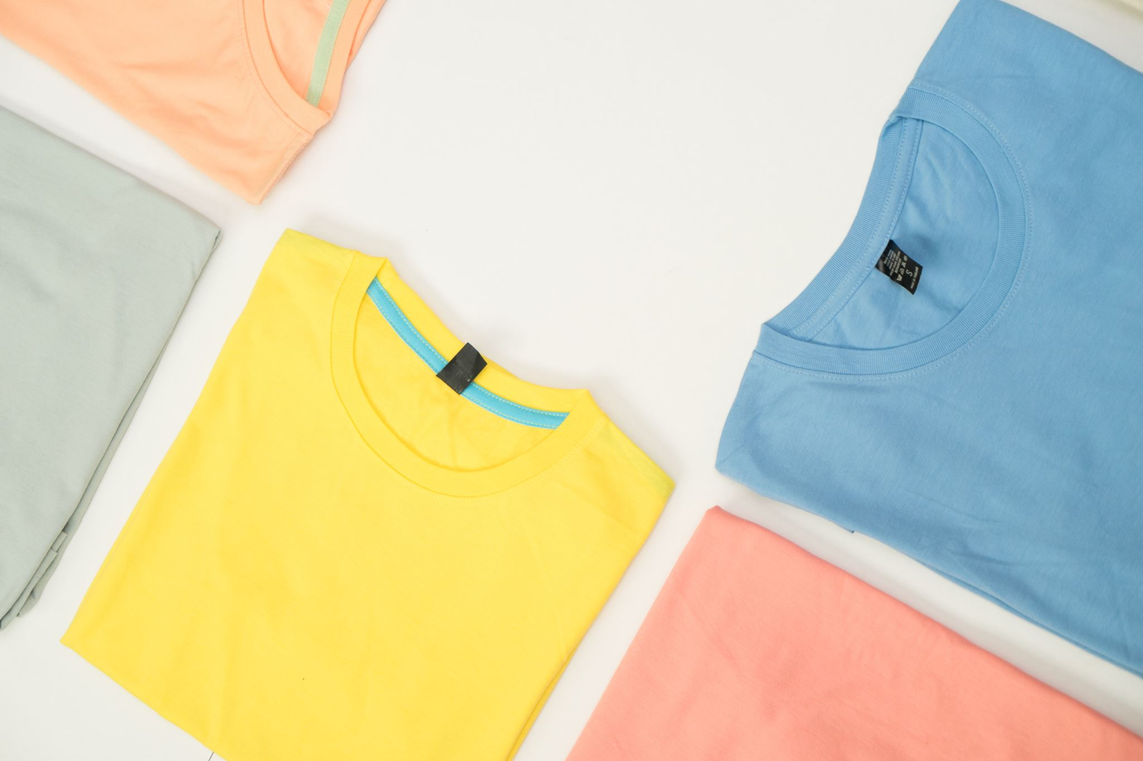
Here are some specific examples of sustainable and ethical fashion events in Israel
Tel Aviv Fashion Week - This annual event features sustainable and ethical fashion designers from Israel and around the world, promoting eco-friendly and ethical practices in the fashion industry.
Green Fashion Week - This event takes place in different cities around the world, including Tel Aviv. It aims to raise awareness of sustainable fashion and features designers who use eco-friendly materials and production methods.
Sustainable Fashion Night - This event is hosted by a local sustainable fashion brand and includes a fashion show, pop-up shop, and panel discussions with experts in sustainable fashion and ethical production.

Slide 26
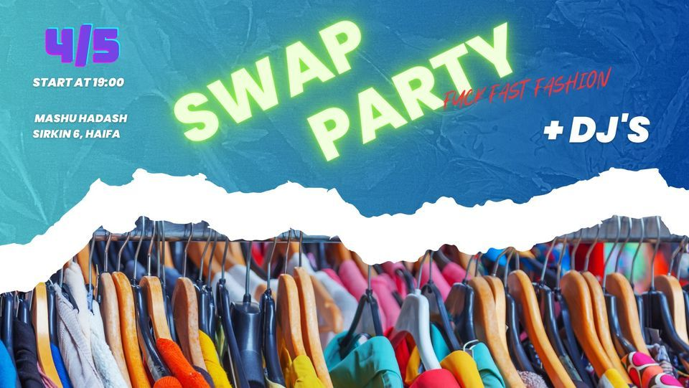

Slide 27
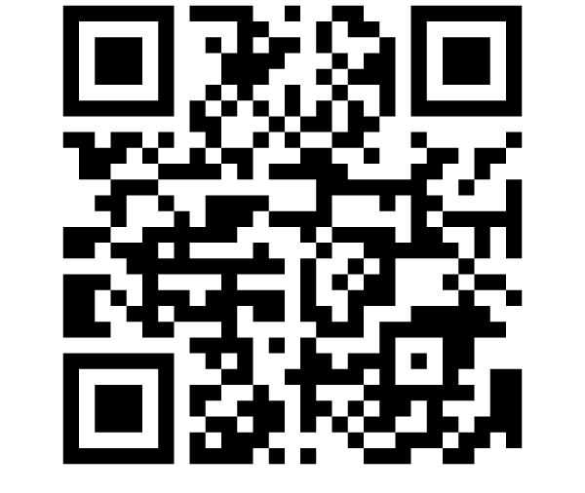
Here we can use Mentimeter

Slide 28
Sources and most useful articles
Ellen MacArthur Foundation, A new textiles economy: Redesigning fashion’s future, (2017, http://www.ellenmacarthurfoundation.org/publication
Textiles in Europe's circular economy https://www.eea.europa.eu/publications/textiles-in-europes-circular-economy
UN Alliance for Sustainable Fashion Home - The UN Alliance for Sustainable Fashion (unfashionalliance.org)
Peleg Mizrachi, M.; Tal, A. Regulation for Promoting Sustainable, Fair and Circular Fashion. Sustainability 2022, 14, 502. https://doi.org/10.3390/su14010502
Niinimäki, K., Peters, G., Dahlbo, H., Perry, P., Rissanen, T., & Gwilt, A. (2020). The environmental price of fast fashion. Nature Reviews : Earth and Environment, 1, 189-200. https://doi.org/10.1038/s43017-020-0039-9

Slide 29
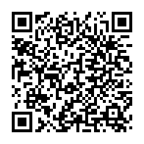
https://1drv.ms/b/s!An2OHLVKkifEiBiY2gVOtvlM6Sez?e=hlkkBq Break into several groups. Open the app using this Quarcode. Read the information about the environmental performance of various fabrics and choose the person in your group who is dressed as sustainable as possible. In case you find it difficult to do so, try choosing the most environmentally friendly dressed person based on other criteria. Think about what conclusions can be drawn from this exercise.

